Slide 1
FLIPROBO TECHNOLOGIES
House Price Prediction
Submitted by:- Twinkle Patel

Slide 2
PROBLEM STATEMENT
Houses are one of the necessary needs of each and every person around the globe and therefore housing and real estate market is one of the markets which is one of the major contributors in the world’s economy. It is a very large market and there are various companies working in the domain. Data science comes as a very important tool to solve problems in the domain to help the companies increase their overall revenue, profits, improving their marketing strategies and focusing on changing trends in house sales and purchases. Predictive modelling, Market mix modelling, recommendation systems are some of the machine learning techniques used for achieving the business goals for housing companies. Our problem is related to one such housing company.
A US-based housing company named Surprise Housing has decided to enter the Australian market. The company uses data analytics to purchase houses at a price below their actual values and flip them at a higher price. For the same purpose, the company has collected a data set from the sale of houses in Australia.

Slide 3
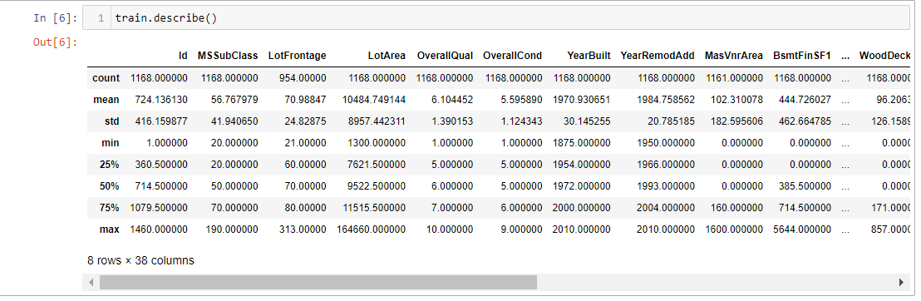
Analytical Problem Framing
We can see that the min value is 0 which is not even possible for most of the features.We created multiple group based on min, 25% to 75%, above 75%.

Slide 4
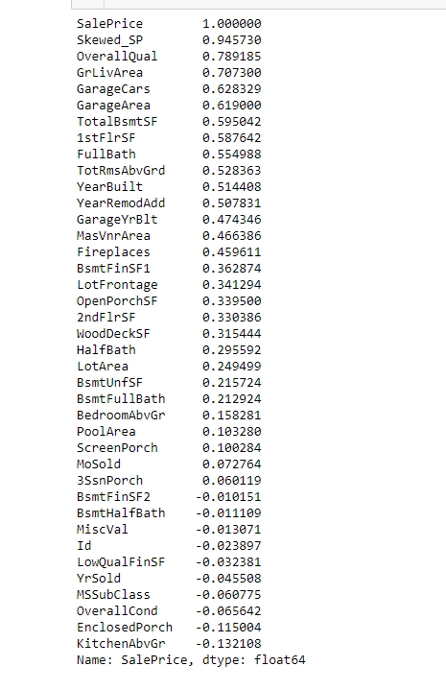
Correlation
The correlation of Sale price with all the other variables is given above.
There are lots of variable which are highly correlated with the sale Price.

Slide 5
Data Preprocessing
Firstly ,We treated the skewness using log transformation.After that , we imputed the missing values and encounted the categorical values using one hot encoding.Finally, we trained the model on the train set and tested the model on the test set .And ,Applied hyperparameters for improving the performance.

Slide 6
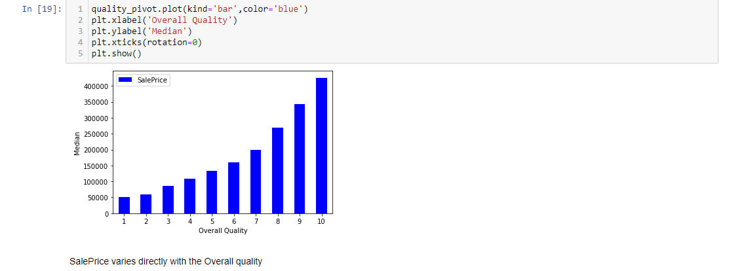
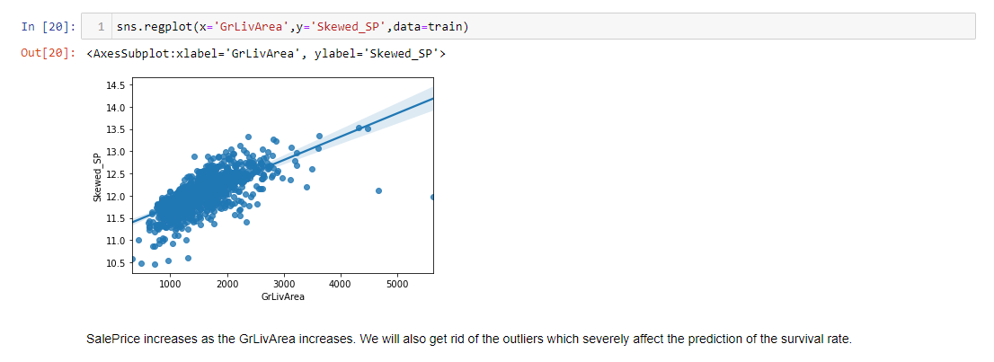
Visualisation
SalePrice varies directly with the Overall quality
SalePrice increases as the GrLivArea increases. So, We will also get rid of the outliers which severely affect the visualized of the survival rate.

Slide 7
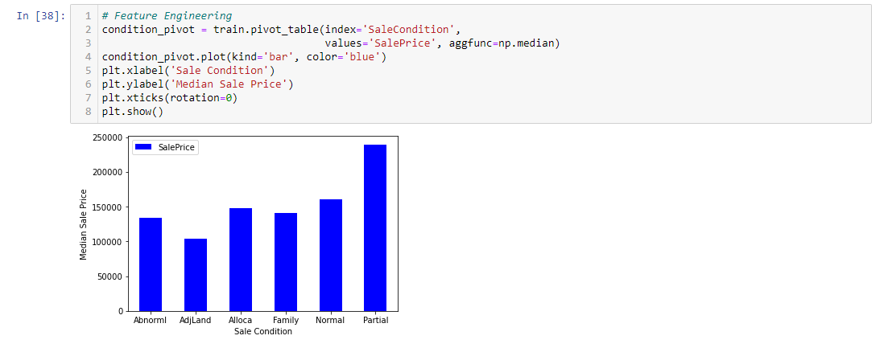
Model/s Development and Evaluation
● Identification of possible problem-solving approaches (methods)

Slide 8
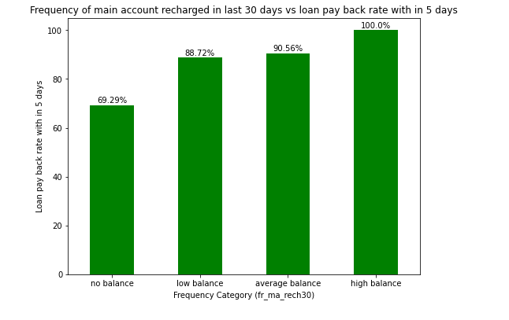
From the above we can see that users with high balance always pays back the loan within 5 days and average and low category only 9% - 12% users failed to payback the loan within 5%, and users with zero balance around 30% users are not paying the loan back within 5 days.

Slide 9
Model Development
Testing of Identified Approaches (Algorithms)
Linear Regression
Ridge Regressor

Slide 10
CONCLUSION
From the above visualization and model building we analyzed that Gradint boost regresor performed better when this type of dataset was given and based on the model performance it can be used to visualize the house price of the house based on numerous factors.
Based on the final model the Real estate company can make decisions and there is a higher possibility that the decisions will be profitable.

